Slide 1

Project setup
DATA ANALYTICS BOOTCAMP | IRONHACK

Slide 2

Contents
Repository structure
Environments
Installing libraries in a given environment.
Initializing a Git repository
Adding a GitHub repository
Git directives
Yaml file

Slide 3
Repository structure

Slide 4
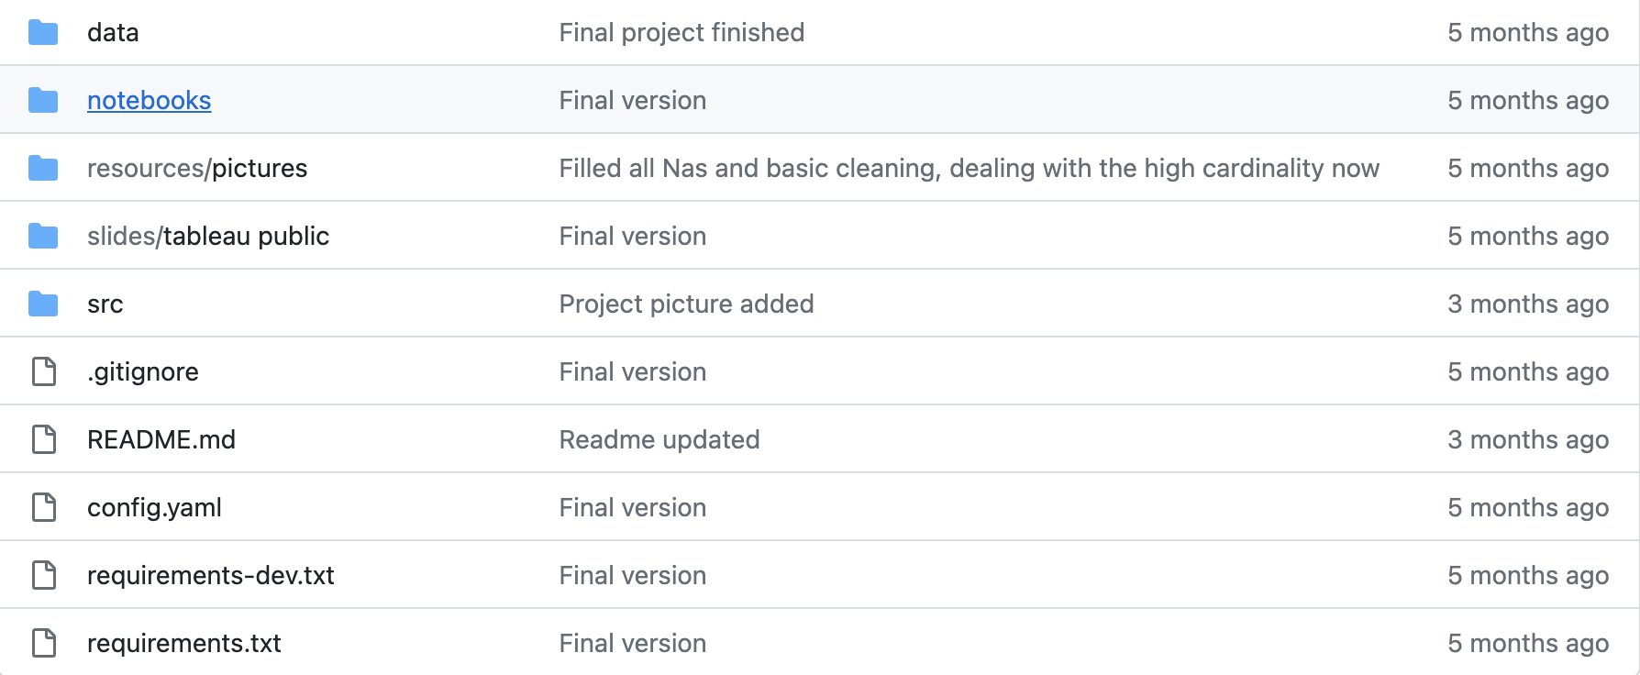
Repository structure and files

Slide 5
Repository files
Please add the following files to your repository:
README.md: Introduce your project's purpose, summarize your findings, and outline future steps. Include a link to your data source.
requirements.txt: List all libraries and their specific versions used in your project for a production environment.
requirements-dev.txt: Detail the libraries and their versions used in your project, excluding dependencies related to Jupyter.
config.yaml: Create a YAML file to store all project settings, such as directory paths, random seeds, ML model parameters, etc.
.gitignore: Specify the files and folders you do not want to commit to your repository.
Remember ‘.gitignore’ has a period before the file name

Slide 6
Repository folders (I)
Please structure your repository by adding the following folders and files:
data/
raw/data.csv (original data file)
cleaned/data_cleaned.csv (cleaned file)
slides/
Add here any presentation files, tableau urls etc

Slide 7
Repository folders (II)
If your project involves creating a machine learning model, please add the following folders to your repository to organize different components:
transformers/
Use this folder to store any fitted transformers that you use in your model.
scalers/
This folder should contain any scalers that are applied in your data preprocessing or model training process.
encoders/
Store any encoders (like label encoders or one-hot encoders) used for data preparation in this folder.
models/
Use this folder to store all the trained machine learning models.

Slide 8
Repository folders (III)
Add the following folders to your repository:
notebooks/
Exploratory notebook: Use this notebook for all your tests. Include Markdown cells to explain your actions and their purposes.
[Clean_notebook]: This notebook should contain the polished, final version of your tests, ready for presentation.
If your project involves creating a model, consider adding these:
src/
main.py: This Python file should handle loading, cleaning, training, and saving your models.
lib/
Functions.py: Place all custom functions that your project requires in this file.
__init__.py: This empty file will make Python treat the directories as containing packages."

Slide 9
Repository folders (IV)
In your functions.py file, include all necessary import statements outside of the function definitions. Then, define all your functions within this file.
In your main.py file, add the following lines at the end:
if __name__ == “__main__”:
function1()
function2()
This code structure ensures that when you run main.py, either from your notebook or directly from the Terminal, it will execute function1() and function2() as intended.

Slide 10
Repository folders (V)
If you are developing an app, please add the following folder to your repository:
app/
This folder should contain all Python files necessary for creating the frontend of your application. This may include scripts for user interfaces, data visualizations, or any other components that contribute to the frontend functionality.

Slide 11
Environments

Slide 12
Environment
An environment is an isolated space on your computer that allows you to install specific versions of libraries without affecting other projects or the system as a whole.
When you install Anaconda, it comes with a default environment named 'base', where all the libraries are initially installed.
When you open a new terminal, it starts in the default 'base' environment of Conda.
It's a good practice to create separate environments for different projects to manage dependencies more effectively. For your project, create a new environment within your project folder.

Slide 13
Environment tools
There are two primary environment management tools available for Python:
Conda
Anaconda can only “see” “conda” environments.
Every notebook opened with Anaconda is launched in the conda “base” environment.
Venv
Is commonly used with IDEs like VSCode and PyCharm. It's not integrated with Anaconda, so environments created with venv won't be visible or manageable through Anaconda Navigator.
Others: such as virtualenv and pipenv.

Slide 14
Venv environments

Slide 15
How to create an environment using venv
For Linux/MacOS: Open a Terminal.
For Windows: Open an Anaconda Powershell Prompt. (Note: While venv is not directly integrated with Anaconda, you can still use the Anaconda Powershell Prompt to create a venv environment.)
Navigate to your project folder using the command line (`cd` command followed by the path to your project folder) and create the virtual environment:
cd path/to/your/project python -m venv environment_name
Replace `environment_name` with the name you wish to give to your environment for your project. This command creates a new folder named `environment_name` in your project directory, which contains the environment.

Slide 16
Activating/deactivating venv environments
For Windows:
To activate the virtual environment, navigate to your project folder in the terminal. Then, use the following command:
environment_name\Scripts\activate
To deactivate the environment type, simply type::
deactivate
For Linux/MacOS:
To activate the virtual environment, navigate to your project folder in the terminal. Then, use the following command:
source ./environment_name/bin/activate
To deactivate the environment, type:
deactivate

Slide 17
Installing libraries in venv environments
Navigate to the project folder
Activate Your Project Environment: Ensure that your project's virtual environment is activated.
Upgrade pip: to ensure you have the latest version.
python -m pip install --upgrade pip
Install Required Libraries:
pip install library_name
If you need a specific version of the library, specify the version like this:
pip install library_name==version
Replace library_name with the name of the library and version_number with the desired version.
Install pip-tools, Jupyter, and ipykernel:
pip install pip-tools ipykernel

Slide 18
Environments and Jupyter

Slide 19
Opening Jupyter notebooks in an environment
By default, Jupyter Notebooks are not configured to recognize virtual environments created outside of its system. To enable Jupyter to access these external environments:
Install the Kernel for Your Environment: ensure that your virtual environment is activated and in the terminal type:
python -m ipykernel install --user --name=environment_name
Restart Jupyter Notebook: close any running instances of Jupyter Notebook and re-open Jupyter Notebook to refresh the list of available kernels.
Launch Jupyter Notebook in Your Environment: Navigate to your project folder in the terminal, ensuring that your environment is still activated and launch Jupyter Notebook
cd path/to/your/project
jupyter notebook

Slide 20
Requirements files

Slide 21
What is it and why we need it?
A requirements file lists all the libraries and their specific versions required to run your programs.
Different versions of a library can have varied functionalities. Some functions that your code relies on might not be available in older or different versions of a library.
Simply having the same library installed on a different system doesn't guarantee that your code will run error-free. The exact versions of the libraries used are essential.

Slide 22
Generate requirements using piptools
Open the terminal.
Activate the venv environment.
Create a requirements-dev.in file.
Use a text editor like Sublime to create it.
In this file, list all the libraries used in your Python programs. Each library should be on a separate line.
Create requirements.in file.
At the beginning of this file, add the following line:
-c requirements-dev.txt
Then, list any additional libraries that are not included in `requirements-dev.in`, such as `jupyter`. Each library should be on a separate line.
By following these steps, you create two files: `requirements-dev.in` for development dependencies and `requirements.in` for production dependencies, with `requirements.in` referencing `requirements-dev.txt` to ensure consistency between development and production environments.

Slide 23
Generate requirements using piptools
To generate requirements.txt and requirements-dev.txt files:
Navigate to your project folder
Activate the correct environment
Compile requirements-dev.in and requirements.in :
python -m piptools compile requirements-dev.in
python -m piptools compile requirements.in
These commands will create requirements.txt and requirements-dev.txt in your project folder. These files will include all the library versions specified in your *.in files, ensuring consistent environments for development and production.

Slide 24
Initializing a git repository

Slide 25
Initializing a git repository
Move to your project folder and type:
git init

Slide 26
Adding a GitHub repository

Slide 27
Initializing a GitHub repository and linking it
Create a new repository on GitHub: Go to your GitHub page and create a new repository.
Copy the repository URL: Once the repository is created, copy its URL.
Link Your Local Project to GitHub: Open a terminal window in your project folder and type the following command, replacing remote_url with the actual URL you copied:
git remote add origin remote_url

Slide 28
Git steps

Slide 29
Mandatory (I)
At the end of each day:
If you have files larger than 20MB in your project folder:
Option A: Handling Large Files Without Git LFS
Handle Tableau Workbooks: Instead of including large Tableau workbooks, add a Markdown file with a link to your public repository where these can be accessed.
Compress Large Data Files
Update .gitignore: Add a .gitignore file. Inside it, list any files or folders you do not wish to commit, such as the original large files or other non-essential items.
Option B: Using Git LFS
Consider using Git Large File Storage (LFS) for managing large files. Visit Git LFS for setup and usage instructions.
Finalizing Your Daily Commit
Add files to staging area
Create a commit
Push changes to your repository.

Slide 30
Config.yaml file

Slide 31
YAML file
A YAML file is a plain text configuration file, used to externalize the data and settings that your code relies upon. This prevents hard-coding values directly into the code, facilitating easier maintenance and scalability, and allowing for easy adjustments without altering the code.
Specifying paths for data storage, model files, transformers, scalers, and other project-related directories. Storing names of database tables, columns etc.
Defining parameters, constants and hyperparameters for machine learning models.
Managing settings for various environments (development, testing, production).
YAML files are structured hierarchically. In the following structure, 'Section' represents a category, and under each section, you list the relevant parameters and their values.
Section: Parameter: value

Slide 32
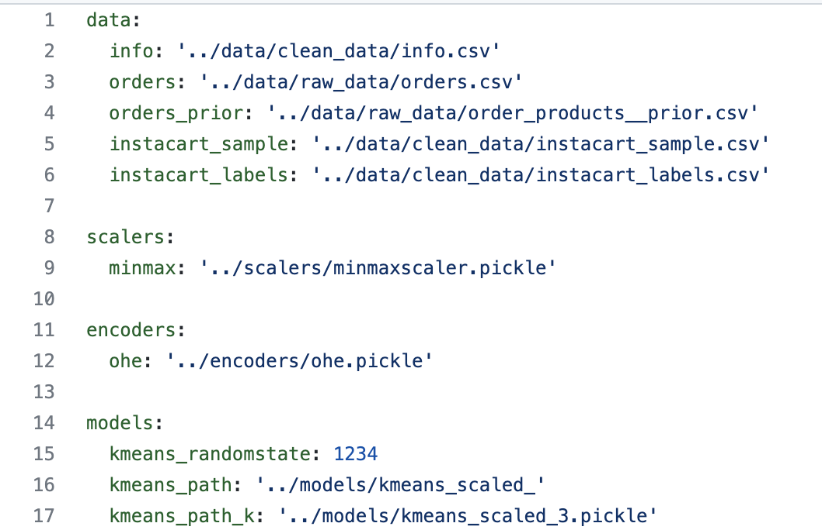
Example Yaml file

Slide 33
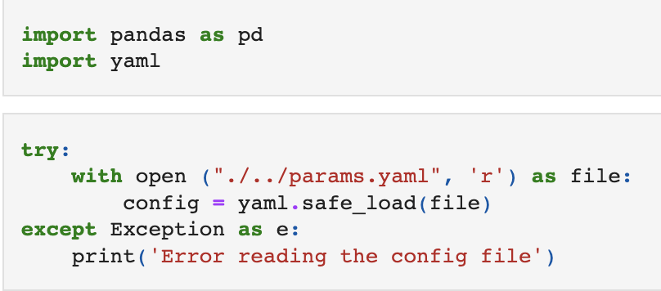
Reading a Yaml file in Python

Slide 34

Reading yaml files
To read a yaml file we need the library “yaml”.
import yaml
We can read and store all the parameters from a yaml file using:
with open(“path_to/parameters.yaml”) as conf_file:
config = yaml.safe_load(conf_file)
“config” variable is a “nested” dictionary:
config[‘train’][‘neighbours’]....
Notes:
Note. In project 2 it doesnt apply, but you can tell the students that its there for project 3.

Slide 35
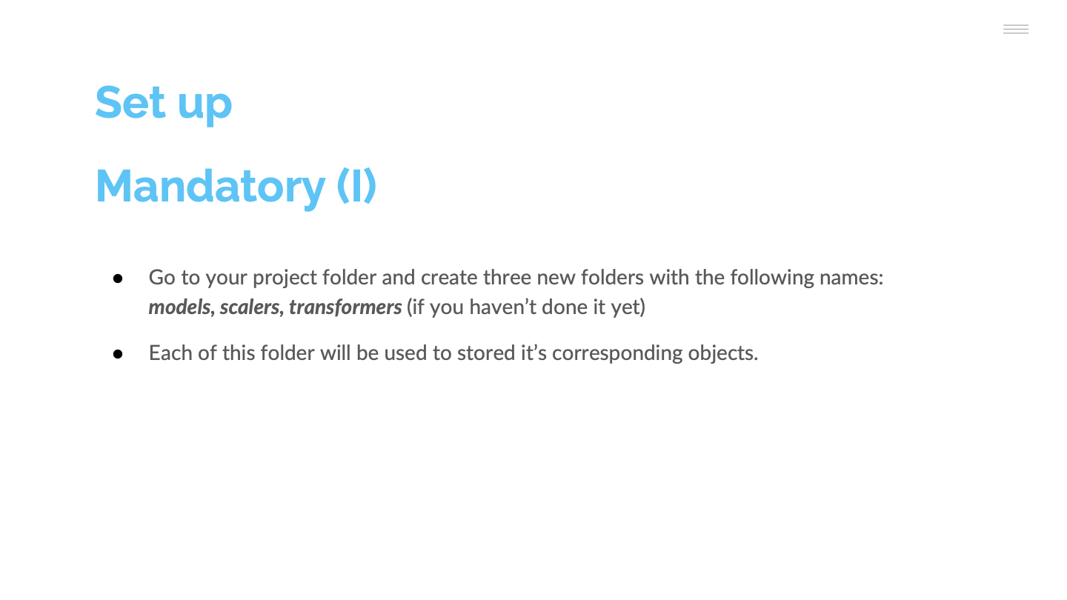
Yaml file
Is a configuration plain text file.
The purpose of this file is to host all the parameters needed by your notebooks/codes, ie:
Folders of data, transformers, scalers, models,....etc
Random seed
Hyperparameters of each of your models
It has a hierarchical structure
section:
Parameter: value

Slide 36
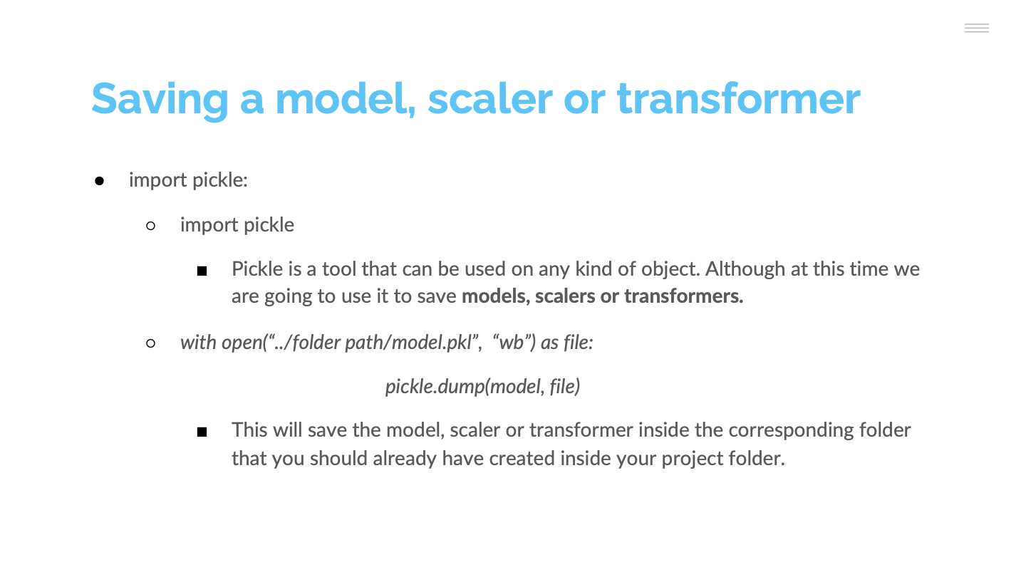

Slide 37
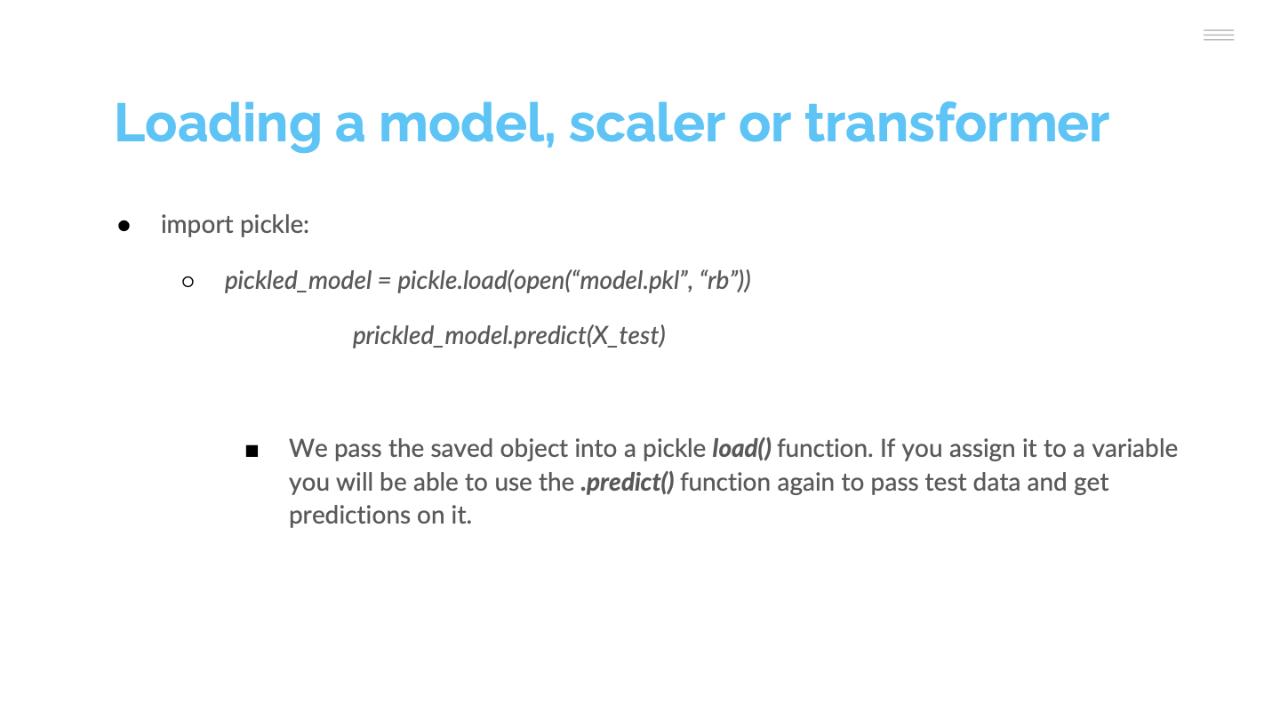

Slide 38


Slide 39
Conda environments

Slide 40
How to create an environment using conda
conda create --name environment_name pip python jupyter
This will create a folder for the environment called “conda-env” in your current folder. In addition, it will install “pip”, “python” and “jupyter” in the environment.
Afterwards, it’s interesting to install another library called “pip-tools” which is only available on the Python official repositories, not in conda. For this reason, we need to install it using “pip”
pip install -U pip pip-tools

Slide 41
Activating/deactivating conda environments
To activate a conda environment, move to the project folder and type
conda activate
To deactivate a conda environment, move to the project folder and type:
deactivate

Slide 42
Installing libraries in conda environments
To install libraries in conda environments:
Move to the project folder
Make sure that the environment is activated
Type:
conda install library_name
conda install library_name=version

Slide 43
Generate a requirements using conda
Conda uses yaml files to store all the information related with a given environment.
Open the terminal
Activate the conda environment
Type:
conda env export --file requirements.yml

